Slide 1
GCAM Tutorial
The GCAM Development Team
2021 GCAM Annual Meeting
Notes:
Stock Image

Slide 2
General Outline
Preliminary: Software to Download
Part 1: Running the GCAM Reference Scenario
Part 2: Running alternative scenarios
Part 3: Changing input files
Part 4: Debugging
Part 5: Additional Resources
Part 6: Theory and meaning of parameters

Slide 3
Preliminary: software to download
GCAM: https://github.com/JGCRI/gcam-core/releases
Java Runtime Environment (64 bit) https://jdk.java.net/16
To compile GCAM code:
http://jgcri.github.io/gcam-doc/gcam-build.html
R: https://cran.r-project.org/ and Rstudio https://www.rstudio.com
On Windows you may need the Visual Studio Redistributable (for 2015/2017/2019)
https://support.microsoft.com/en-us/topic/the-latest-supported-visual-c-downloads-2647da03-1eea-4433-9aff-95f26a218cc0

Slide 4
Preliminary: software to download
Optional but helpful
On linux (or Mac), you can use vi, emacs, or your favorite text editor. On Mac/windows, XML files will open in a text editor, but there are other options
Windows: XML Marker: http://symbolclick.com/xmlmarker_1_1_setup.exe
Mac: BBEdit: http://www.barebones.com/products/bbedit/
Mac: XML Author: http://www.oxygenxml.com/
On Mac and linux, you can use `diff` to compare files, but for more visual options:
Windows: Tortoise Git: https://tortoisegit.org/download/
Windows: WinMerge: http://winmerge.org/downloads/
Mac or Windows: DiffMerge: https://sourcegear.com/diffmerge/downloads.php

Slide 5
Part 1: Running the GCAM Reference Scenario
Location of key files
Building GCAM and the GCAM data system
How to run the model
Looking at, interpreting, and exporting the output
Introduction to the diagnostics package

Slide 6
The GCAM repository
If you have cloned the full GCAM repository, you will see four key folders:
cvs
exe
input
output
Model code, project files
Executable and configuration
Input files, including the data system
Model outputs, queries, diagnostic package

Slide 7
Building GCAM
Most users will not need to build GCAM and can use the pre-built package.
If you do need to build GCAM, getting everything set up the first time can be challenging, but it is typically easy after that. The instructions on the next slide assume that you have gotten it set up correctly (including having installed all the third-party libraries GCAM relies on).
For more information, see http://jgcri.github.io/gcam-doc/gcam-build.html

Slide 8
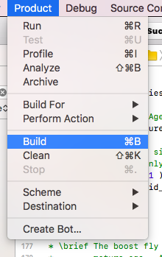
Building GCAM
First, make sure you have installed Hector.
From a command prompt, type `make install_hector`
Or: `git submodule update --init ../../climate/source/hector`
Then, build GCAM
From Visual Studio, use the “Build Solution” option in the “Build” menu.
From Xcode, use the `Build` option in the `Product` menu.
Legacy Build System seems to be more reliable and can be set under File→ Project Settings -> Build System
From a command prompt, type `make gcam`
Note you can use the –j option to speed this up.

Slide 9
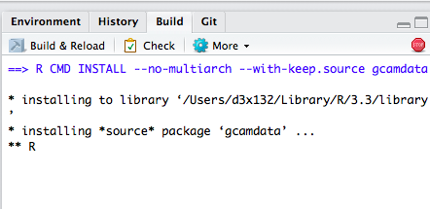
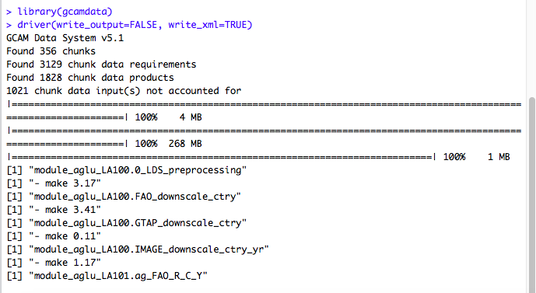
Building the GCAM data system
From R,
Navigate to the data system (input/gcamdata) and open the project file (gcamdata.Rproj)
Build the package (either from the Rstudio `Build & Reload` option or by typing `library(gcamdata)`)
Run the driver (`driver(write_output=FALSE, write_xml=TRUE)`)
From a command prompt,
Navigate to the top of the repository (gcam-core)
Type `make xml`
xml outputs will be saved in `input/gcamdata/xml` when the data system finishes
Notes:
If you download the release package, the xml files will come pre-built
Note: Need to install the package with dependencies:
> install.packages(“devtools”)
> devtools::install_deps()

Slide 10
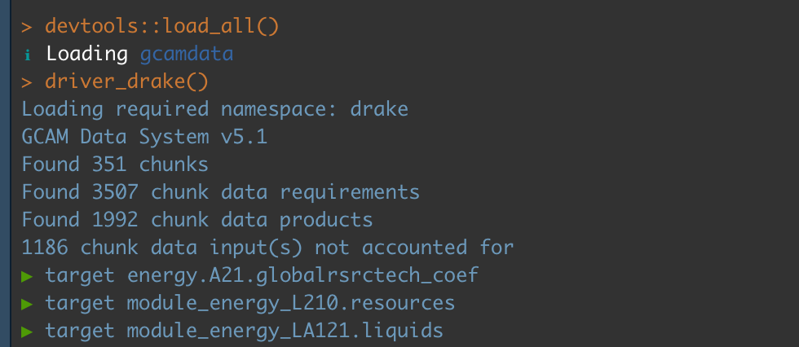
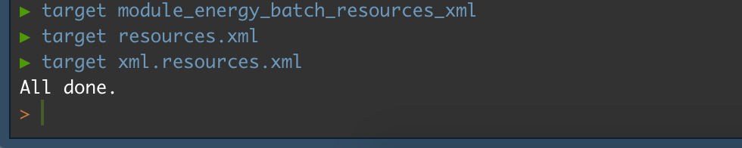
Building the GCAM data system with driver_drake
You can get “make” functionality when building the GCAM data system by using `driver_drake` instead of `driver`
An additional R package will need to be installed: `drake`
Extremely useful when developing in the GCAM data system or using it to generate alternative XMLs by tweaking assumptions
All of the features are documented in `input/gcamdata/vignettes/driverdrake_vignette.Rmd`

Slide 11
The GCAM Configuration File
Default versions for 32 region GCAM (configuration_ref.xml) and GCAM-USA (configuration_usa.xml) are provided in the `exe` folder.
The configuration file defines the GCAM scenario that is run, including what inputs to use, what mode to run, etc.
Unless otherwise specified, GCAM will use `configuration.xml` in the `exe` folder.
This file does not exist when you download the gcam repository and will need to be created.

Slide 12
The GCAM Configuration File
Six different sections:
Files
Scenario Components
Strings
Bools
Ints
Doubles

Slide 13
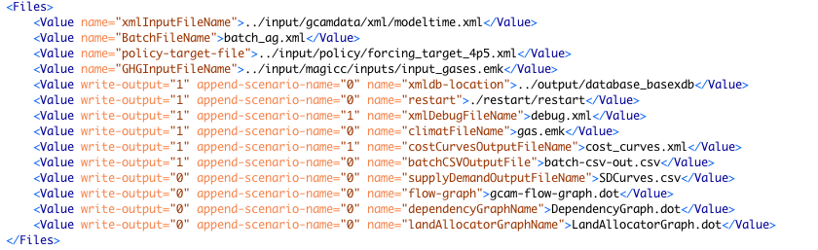
The GCAM Configuration File: Files
Base input file. ScenarioComponents append to this.
For running multiple scenarios in sequence. Requires setting BatchMode bool to 1
For running climate target finder. Requires setting find-path bool to 1
xmldb is where the output will be saved
* Write-output: indicate whether to create the file
* Append-scenario-name: indicate whether to append the scenario name to the name of the file being created

Slide 14
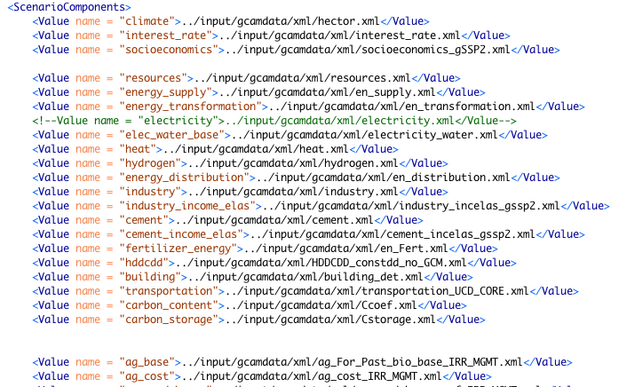
The GCAM Configuration File: Scenario Components

Slide 15
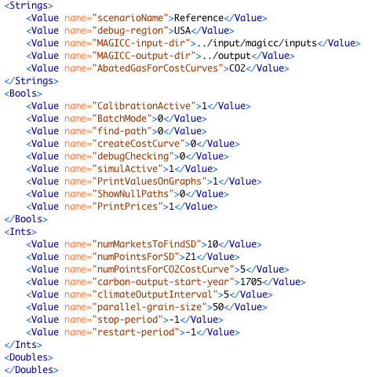
The GCAM Configuration File: Strings, Bools, Ints, Doubles
No spaces or special characters
The debug file has a lot of detail but is only written for one region
Always keep calibration on
If true, appends XML files listed in BatchFile
If true, uses policy-target-file
If true, calculates cost (area under the MAC curve)

Slide 16
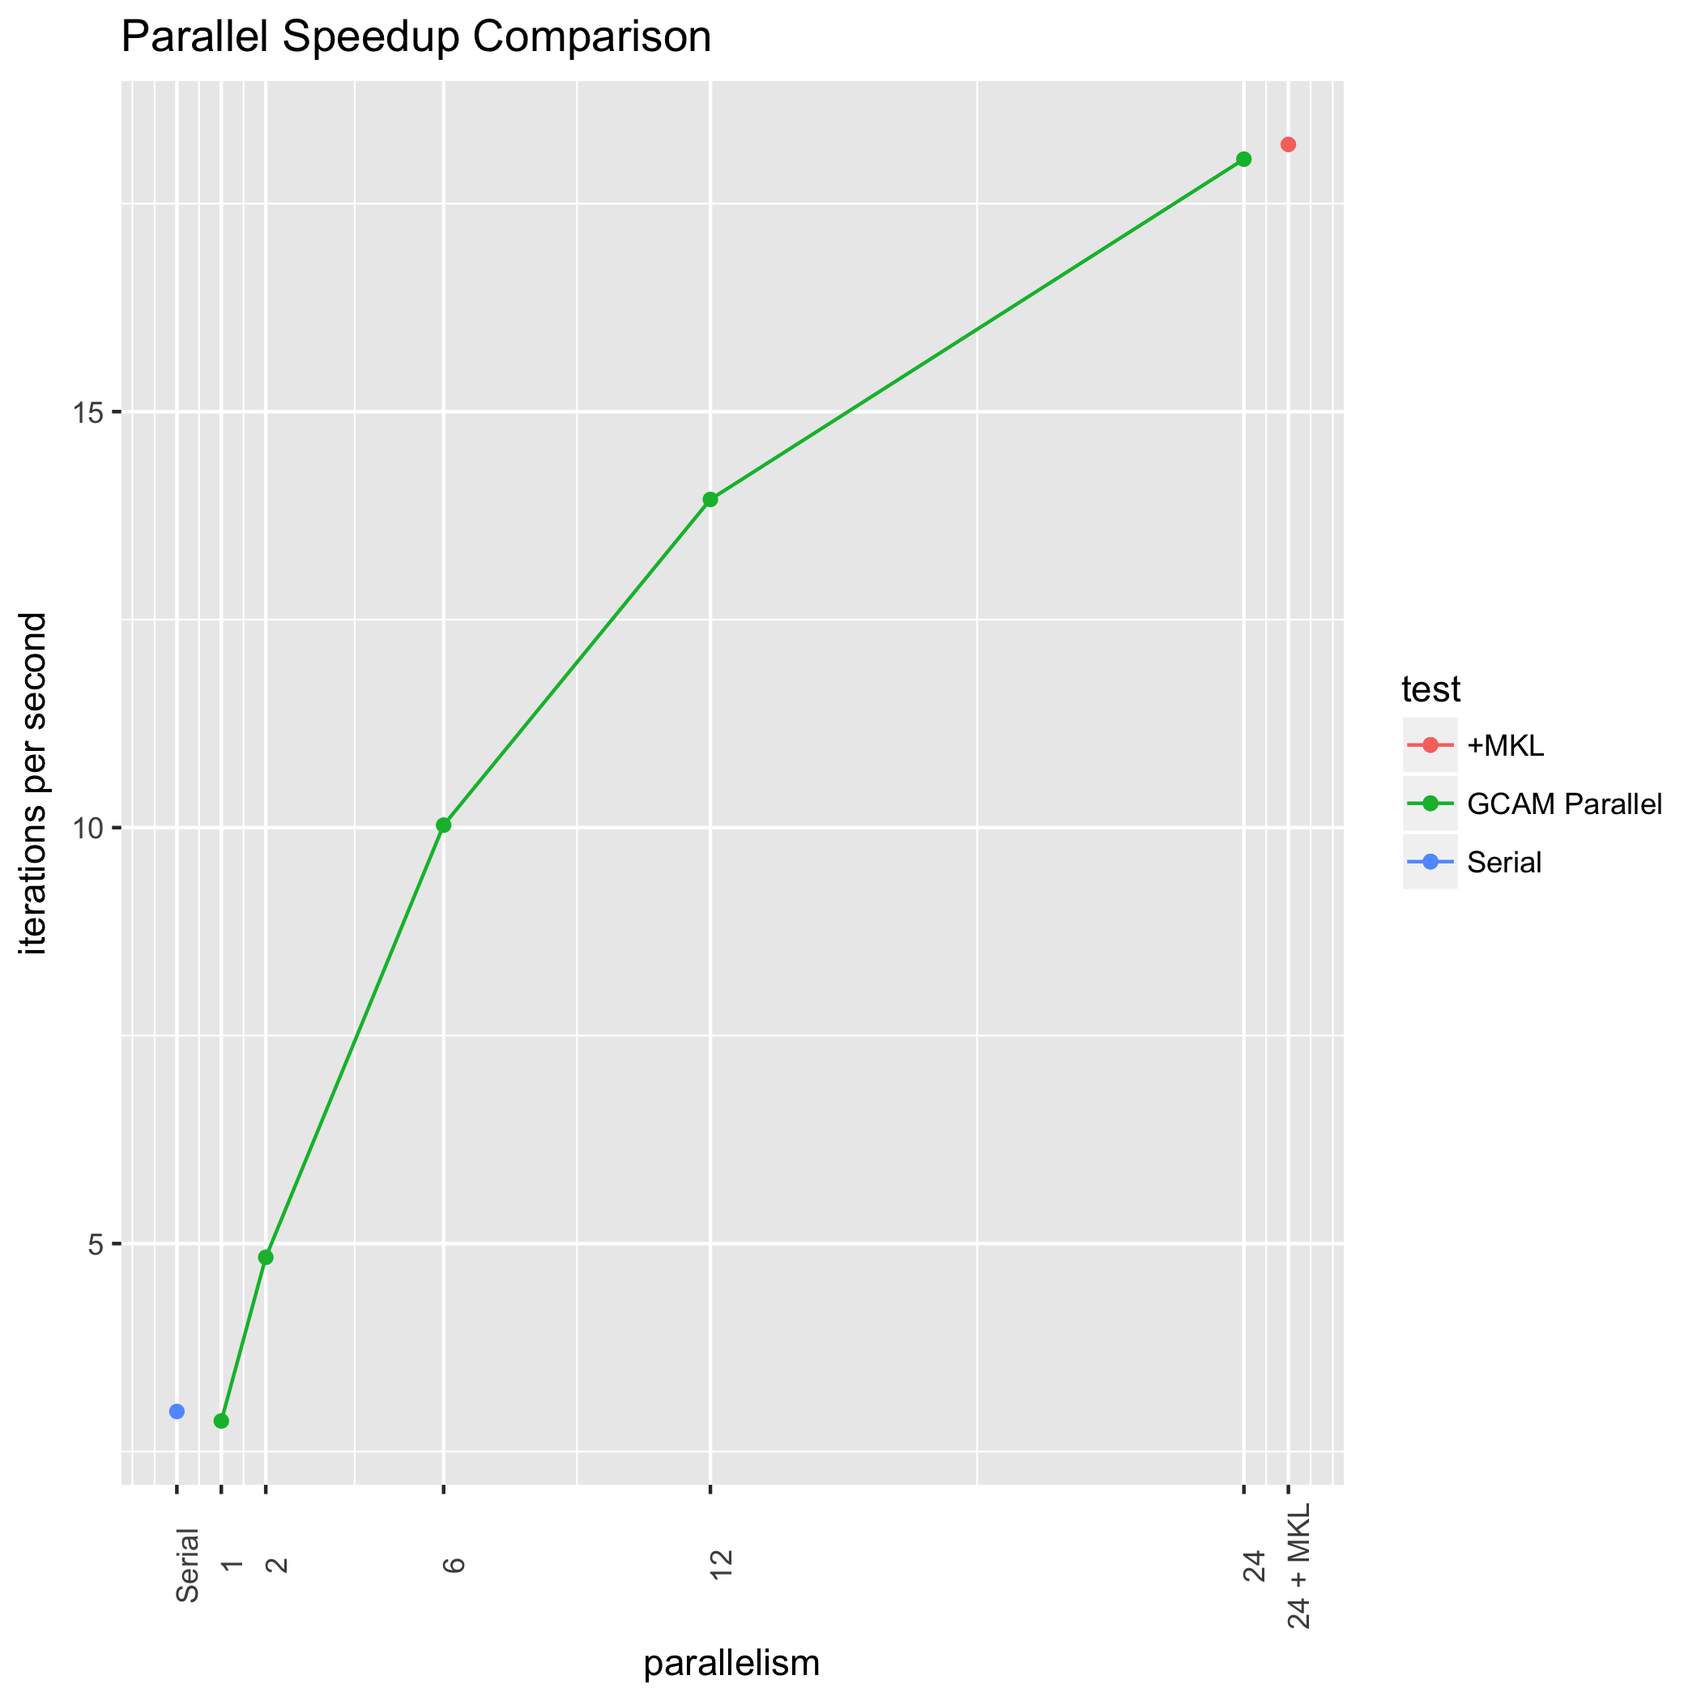
GCAM Parallel
Users can control the number of CPU cores GCAM will use to perform calculations by changing "max-parallelism” in the <Ints> section of the configuration file.
The default value, -1, indicates use all available CPUs
There are diminishing returns in terms of speed up when adding more CPUs
Note, some variability in iteration counts can be expected due to the stochastic nature of parallel computations. However, results will always be replicated within solution tolerance

Slide 17
Running the GCAM Reference Scenario: Windows
Navigate to the `exe` folder.
Create a `configuration.xml` file by copying the `configuration_ref.xml`.
Run GCAM:
From Visual Studio press the green play button
From windows explorer, double click `run-gcam.bat`

Slide 18
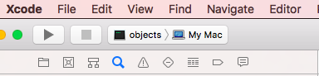
Running the GCAM Reference Scenario: Mac
Navigate to the `exe` folder.
Create a `configuration.xml` file by copying the `configuration_ref.xml`.
Run GCAM
From Xcode, hit the play button
From terminal, type `./Release/gcam` or `./gcam.exe` (depending on how you’ve compiled)
From Finder, double click `run-gcam.command`

Slide 19
Mac: Security Permissions
Note on recent versions of Mac OS users will have to manually allow GCAM and maybe each third-party library that GCAM uses when double clicking `run-gcam.command`
This can be done by opening System Preferences -> Security & Privacy -> General
At the bottom an option will appear to allow GCAM to run
You may need to do this a few times before all required software is allowed

Slide 20
Running the GCAM Reference Scenario: Linux
Navigate to the `exe` folder.
Create a `configuration.xml` file by copying the `configuration_ref.xml`.
Run GCAM
Type `./gcam.exe`

Slide 21
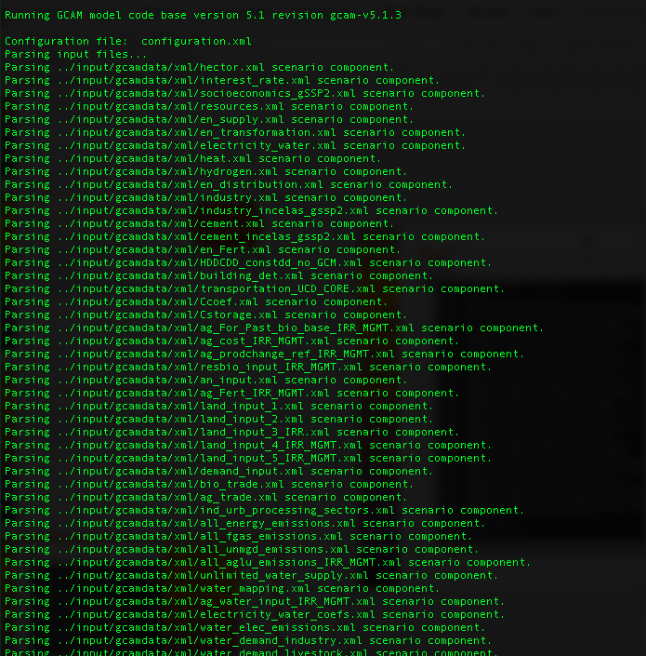

Running GCAM
Command prompt/terminal window contains log messages
These are also written out to exe/logs/main_log.txt. Main log will also contain more information than is printed to screen.
Input files are read in the order that they appear in the configuration.xml file.
Where multiple files refer to the same parameter, the last one read in is the one whose value is used.
Recursive and dynamic: each period is solved independently, but information from one period is passed forward to the next
Deterministic: rerunning the model with no changes to input files will produce exactly the same outcome

Slide 22
Output
The debug file
exe/debugReference.xml (filename set in config and merged with scenario name)
This writes out at the end of each time period, and contains a larger number of parameters for debugging
It is only written for one region, set in the configuration file
The output database
output/database_basexdb (set in configuration.xml)
Contains the results from the scenario in a database that can be queried
Results can also be exported from the database to xml

Slide 23
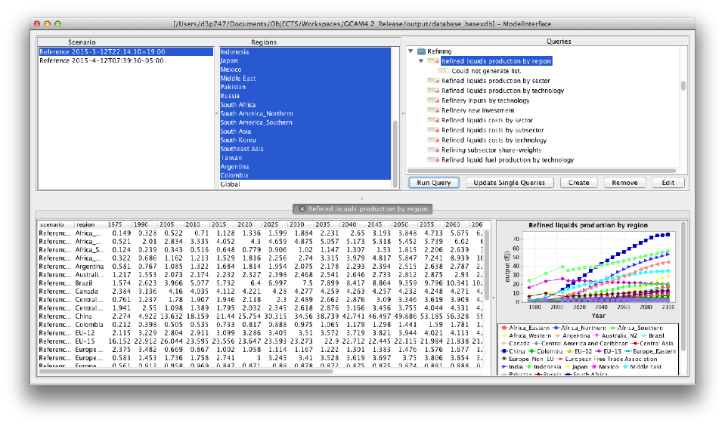
The output database
Open ModelInterface
File -> Open -> DB Open (output/database_basexdb)
Notes:
Note, the very first time you open the ModelIntefface + XML DB it will ask you:
For the output DB as usually
The query file to use, which is in output/queries/Main_queries.xml
Note on Mac, it does not include the labels to tell you which it is looking for so users will need to remember the order

Slide 24
What is in the GCAM Reference scenario?
A high level intro to the XML Inputs

Slide 25
Scenario Components: Climate, Socioeconomics

Slide 26
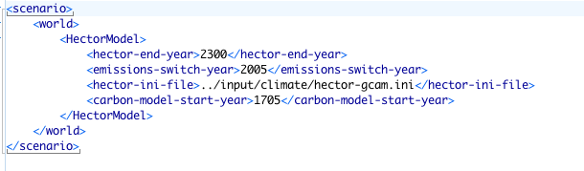
Climate
Default model is Hector, but MAGICC5.3 is still available as an (unsupported) option.
Some options (e.g., when emissions switch from a historical file to GCAM and when to start the carbon cycle) are specified in an xml file. All other options are controlled through the Hector ini file.

Slide 27
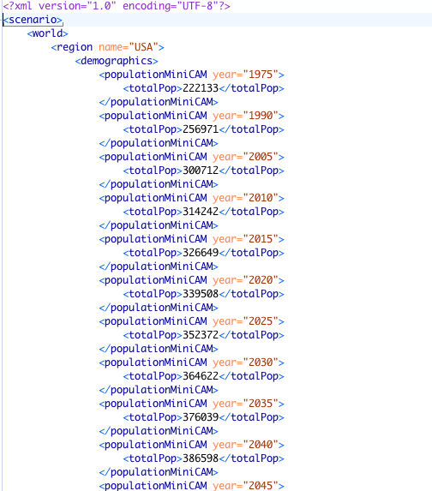
GDP and population
Population and GDP are based on SSP: Shared Socioeconomic Pathways
Population is strictly exogenous (i.e., not modified by other modeled variables)
GDP calculation uses the following formulation:
All parameters to the GDP function are currently exogenous
If you want to change GDP, you will need to change the income elasticities for the industry and cement sectors to be consistent.
Notes:
I

Slide 28
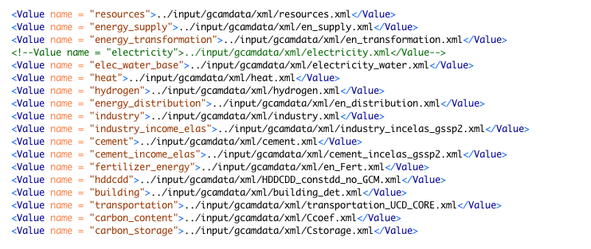
Scenario Components: Energy

Slide 29
General energy system structure
Region #1
Region #2
Primary resources are traded between regions
Primary Resources
Primary Resources
All energy losses and cost mark-ups are explicitly modeled in conversions from primary resources to fuels consumed by end users
Energy Transformation Sectors
Energy Transformation Sectors
Modular structure: certain regions may have more detailed sectoral representations than others
End-Use Sectors
End-Use Sectors
Final Service Demands
Final Service Demands
Population and GDP are largely exogenous, and determine future levels of final service demands
GDP
Population
GDP
Population

Slide 30
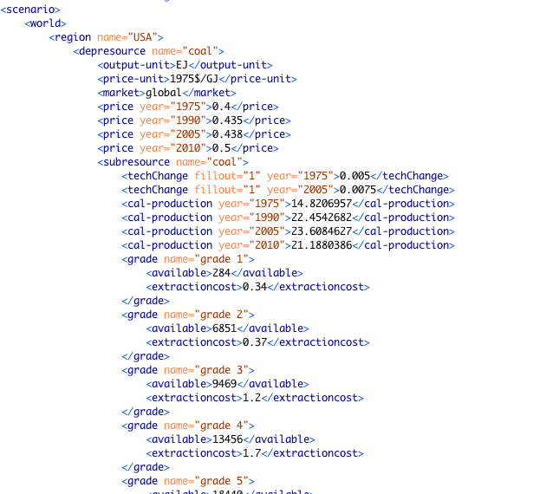
Resources
resources.xml
Coal, oil, gas, wind, solar, geothermal, uranium, MSW, limestone
Resources are represented as supply curves: the level of production at a range of given prices
Prices are in 1975$ / GJ produced. Quantities are in EJ.
Supply curves may be graded, smooth (input as parameters to a logistic power function), or unlimited (e.g. solar, limestone)
Where markets are shared between regions (e.g.“global”), the supply curves of all contained regions are aggregated
Resources may be depletable, renewable, or unlimited.
Cumulative resource extraction is tracked for depletable resources.

Slide 31
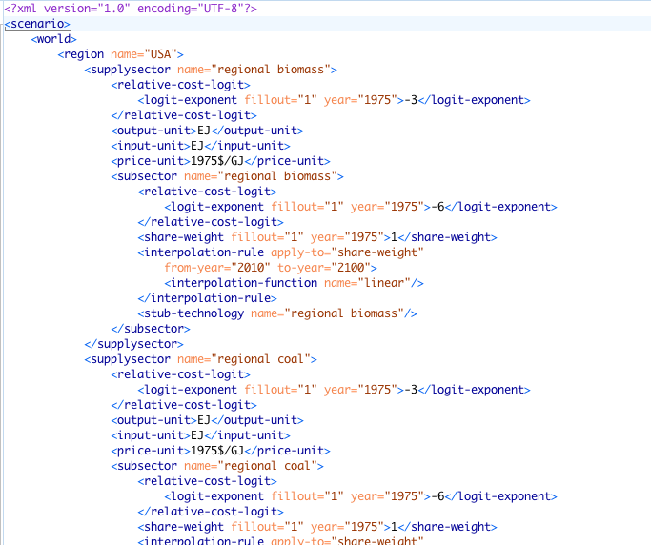
Energy supply
en_supply.xml
Domestic energy supply =
Sum of all consumption within a region
Production minus net exports
These sectors may be used to compete domestic vs imported production
They can be used to implement region-specific energy price adders or subsidies
We currently apply the same cost adders in all regions.
Regional energy prices are not currently calibrated; instead, differences in price/cost across regions are implicitly captured in the derived calibration parameters (i.e., share weights)

Slide 32
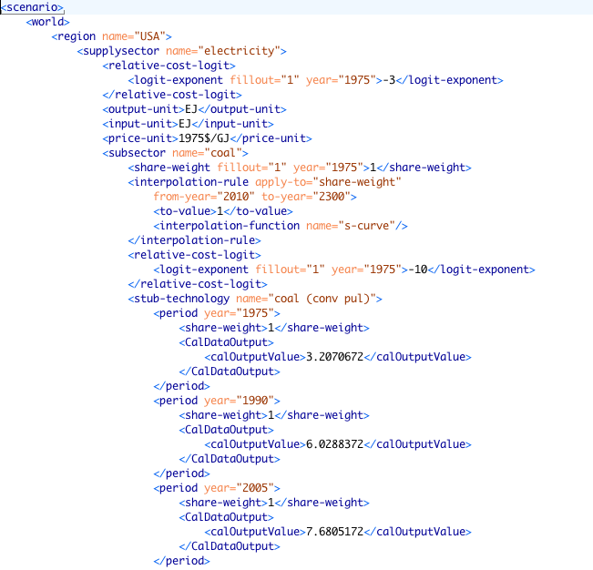
Energy transformation sectors
Five XML files
electricity_water.xml
hydrogen.xml
heat.xml
en_transformation.xml: refining, gas processing, and nuclear fuel enrichment
en_distribution.xml: delivered fuels
Structure: supplysector / subsector / technology
Subsector and technology market shares are currently determined by two-level nested logit choice competition. Infinite nesting is possible and used in GCAM-USA electricity_water.xml for instance.
Technology parameters are specified in each period
Much of the technology-level information is found in the global-technology-database, not in the technologies contained within each region
All technologies must have at least one input (either a resource or another sector)

Slide 33
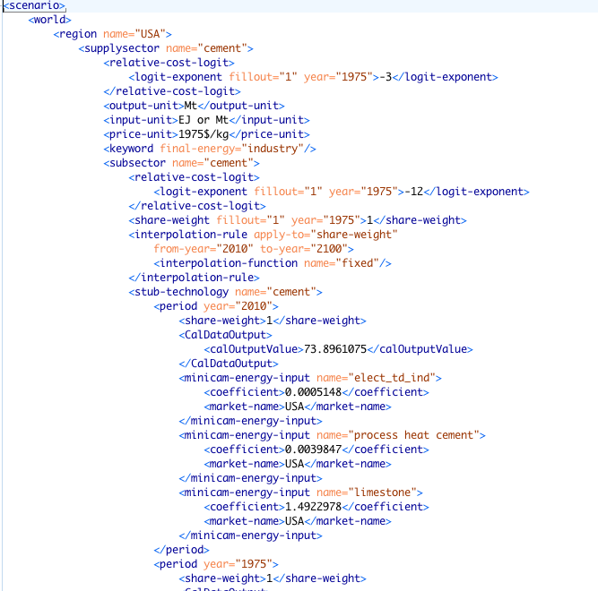
Energy end-use sectors
Sector-specific XML files
building_det.xml
industry.xml
cement.xml
en_Fert.xml
transportation_UCD_CORE.xml
Each has its own structure
Goal is to represent technologies that consume energy and produce physical services and outputs
Keywords specify assignments of from specific to general end use sectors (bld, ind, trn)

Slide 34
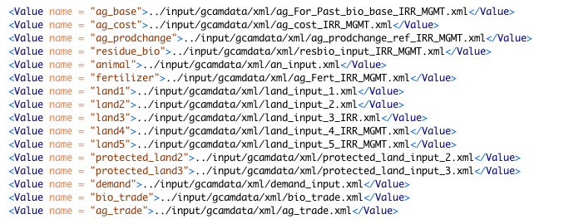
Scenario Components: Agriculture and Land Use

Slide 35
General structure
Region #1
Region #2
CropLand Basin 1
CropLand Basin 2
Cropland determined by endogenous land allocation
CropLand Basin 1
Crop Supply Sectors
Primary agricultural goods are assumed to be traded globally
Crop Supply Sectors
Secondary Agricultural Supply Sectors
Includes ruminant and non-ruminant meat and dairy products
Secondary Agricultural Supply Sectors
Final Service Demands
Final demands include food demands and nonfood demands
Final Service Demands
GDP
Population
GDP
Population

Slide 36
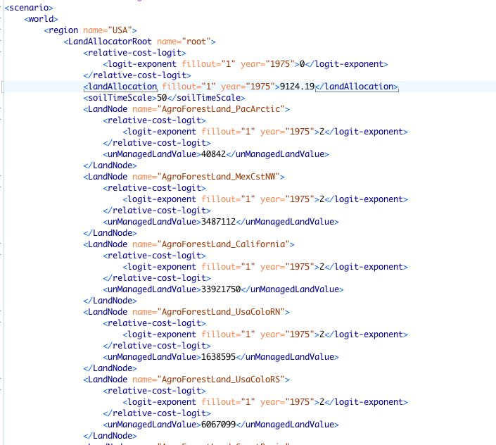
Land allocation
Land data are read in 5 XML files that correspond to the 5 “node” levels of the land nesting diagram
land_input_1.xml, land_input_2.xml, and land_input_3_IRR.xml, land_input_4_IRR_MGMT.xml, land_input_5_IRR_MGMT.xml
Top-level base-year land allocations are fixed in all future periods
At lower levels, land allocations are endogenous
In GCAM, the land use shares shift in response to changes in relative land profit rates
Calibration is performed on land use shares, not present-day rates of land use change

Slide 37
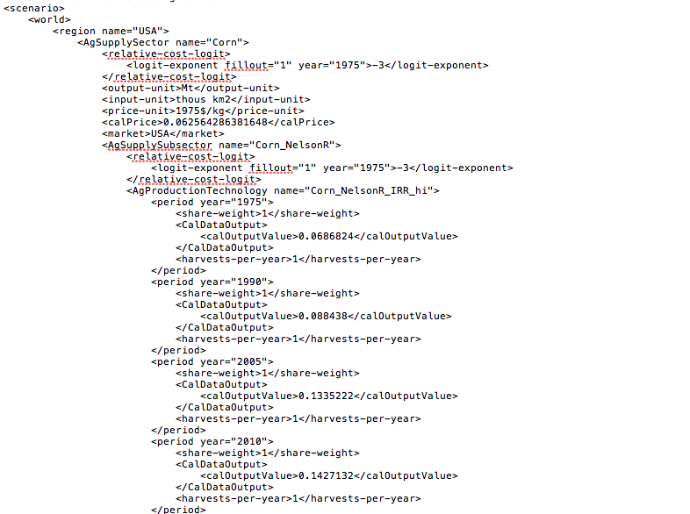
Agricultural production
Each ag production technology has a corresponding land leaf of the same name
The sharing/competition takes place in the land allocator, not in the ag sectors. Share weights are ignored in the ag sectors.
Exogenous variables
Calibrated commodity price (1975$/kg)
Calibrated output (Mt/yr)
Calibrated land quantity (thous km²)
Residue biomass supply curve
Non-CO₂ coefficients (kg gas per kg crop)
MAC curves
Fertilizer inputs (kg N per kg crop)
Costs (1975$/kg)
Future agricultural productivity growth rate (and therefore yield)
Annual harvested area:cropland
Key endogenous variables
Future commodity prices
Future profit rates and production volumes
Notes:
File is enormous – 60MB

Slide 38
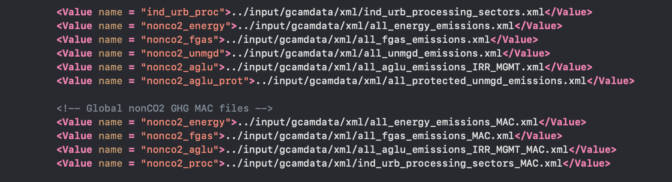
Scenario Components: Non-CO₂

Slide 39
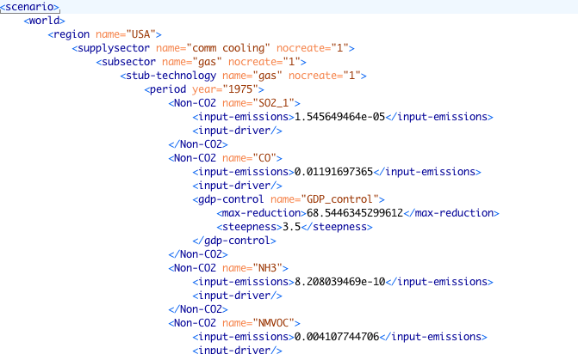



Non-CO₂ gases
Non-CO2 gases are modeled as a by-product on existing activities, either driven by “input” (e.g. fuel consumption) or “output” (e.g. service or energy production)
Can be read in as input-emissions (Tg/yr) or as emissions coefficients (kg/GJ)
GDP control function: emissions coefficients are reduced as GDP increases
MAC = marginal abatement cost curve; decreases coefficients as carbon price increases.

Slide 40
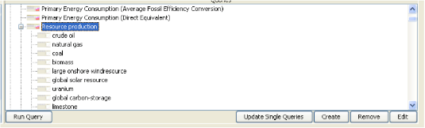
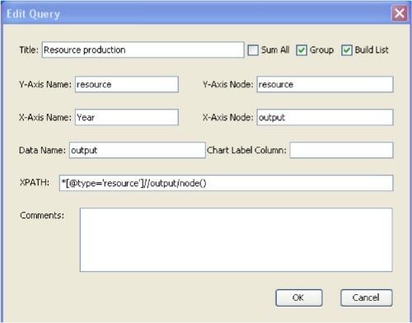
Queries
Update single queries: allows a query to focus on an individual element
Edit query window
Sum All: adds all types of the given element together
Group: builds an area chart and separates each region into a separate chart
XPATH: this is the syntax of the given query.
Note that label re-write lists used in “aggregated” queries are only accessible through the query XML file.

Slide 41
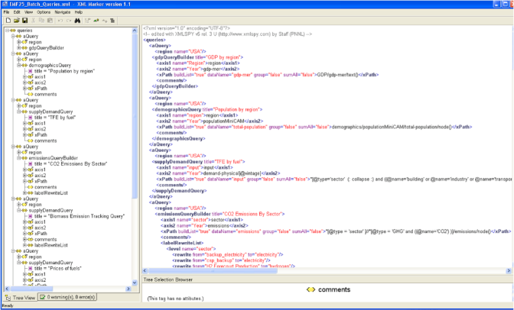
Exporting data to Excel
Drag and drop (e.g. into Excel)
Highlight cells and cut and paste
Use a batch query to export a large number of queries directly into an Excel spreadsheet
The basex database file needs to be open for this to work
File -> Batch File. Select batch query file and output workbook.
This won’t work if the Excel workbook selected is open while running the batch query
rgcam/gcamreader
R/python based tools to import GCAM results directly into R/python.
Available on github.com/jgcri

Slide 42
Running the diagnostics package
The diagnostics package runs R scripts that generate a large number of figures
Can be used for individual scenario analysis or comparisons between a “reference” and alternative scenarios
Currently, queries address end-use energy consumption, electricity, refining, primary energy consumption, land use, emissions, fuel prices, GDP, and population
More can be added in the Model_verification_queries.xml batch query file
The diagnostics package is located in the output/gcam_diagnostics folder
Instructions are found in the readme.txt file

Slide 43
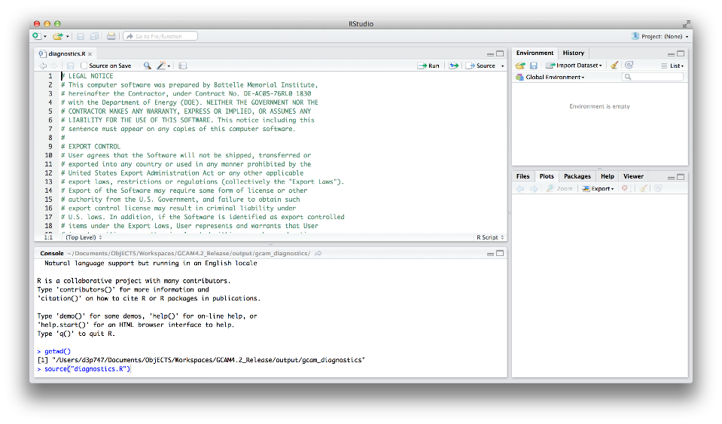
Running the diagnostics package
Check that the working directory is correct, and run the R script

Slide 44
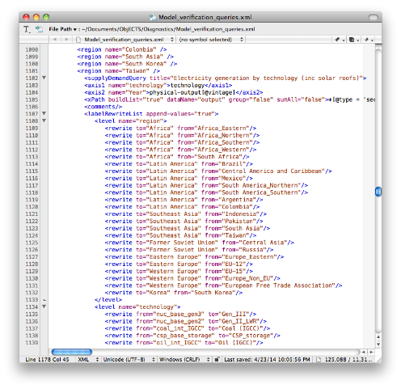
Running the diagnostics package
GCAM regions can be aggregated into world regions for analysis and visualization
use a label re-write list in the model_verification_queries.xml file

Slide 45
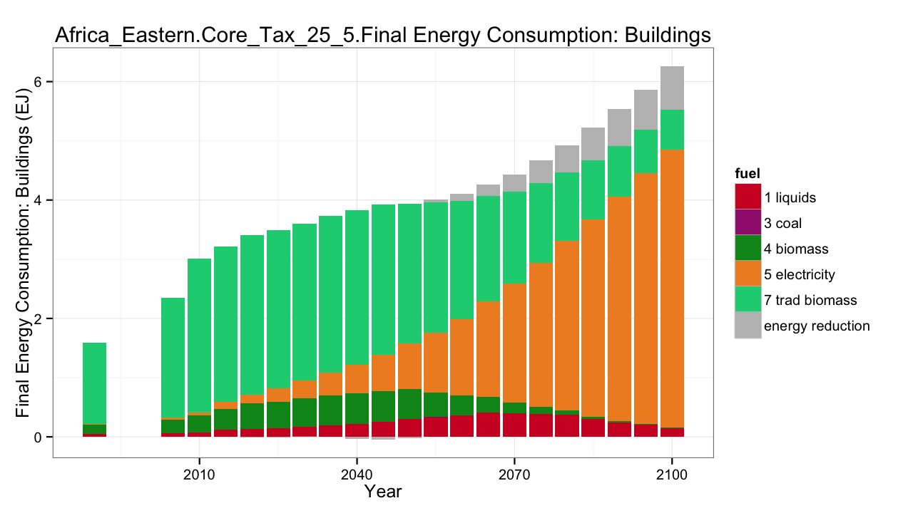
Running the diagnostics package
The default is to compare an “alternative” scenario to a “baseline”, or reference, scenario.

Slide 46
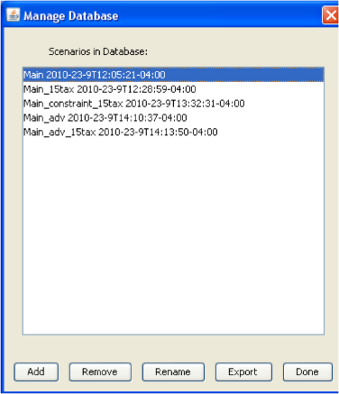
Exporting, importing runs
File -> Manage DB
This allows one to rename, export (as an xml file, that can be imported into another baseX file), import, or remove a run from the database
The exported .xml files can also be useful for writing queries, as they contain all available information that could be queried

Slide 47
Useful Miscellaneous Info
All energy flows are represented in EJ/yr. Note that the “year” denominator is implicit, not written out.
Fuel carbon contents are in kgC/GJ.
Emissions units
CO₂ is in MtC/yr. Multiply by 44/12 to convert to CO₂
Non-CO₂ gases are generally in Tg (same as Mt). Exceptions are the hi-GWP gases (e.g. HFCs, PFCs, SF₆), which are in Gg (same as kt).
Dollar units
Prices of all energy and agricultural goods and services are in 1975$/GJ
GDP is in 1990$/yr
Carbon prices are in 1990$/tC. Multiply by 12/44 to convert to 1990$/tCO₂.
Fuel prices in policy scenarios do not include the emissions penalties. After converting to the desired dollar year, these may be added to any technology as:
C price ($/tC) * 1t / 1000kg * Fuel C content (kgC/GJ) * (1 – sequestration fraction)

Slide 48
Part 2: Running alternative scenarios
Including additional “add-on” XML files
Policies
Running multiple scenarios in batch mode

Slide 49
Running alternative scenarios
Most studies using GCAM will run alternative scenarios
Not an optimization model
“Reference” scenario should not be seen as a most likely scenario; it is simply a no additional policy scenario starting from middle of the road socioeconomic and technological assumptions
Many possible variables of interest:
Different technology futures
Technology policies (e.g., standards, subsidies)
CO₂ and other GHG emissions pricing
Emissions constraints
Land use policies
Future energy prices or taxation
Different population, GDP pathways
This section will focus on the provided policy files in the input/policy folder

Slide 50
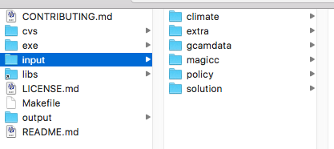
The input folder
All input xml files for a model run are stored in the input folder
Folder structure
gcamdata: generates the XML files from an R package and a set of csv based raw inputs
climate: information for the Hector climate model
magicc: information for the MAGICC climate model
policy: selected policies that can be run
extra: additional files used for the SSPs
solution: solver configuration files

Slide 51
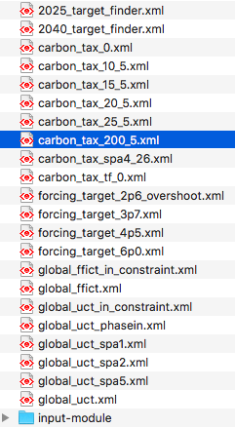
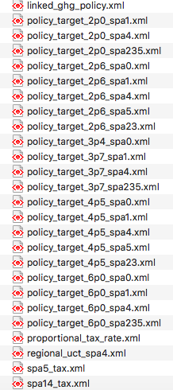
Provided policy files
Carbon cap: constraint on annual CO₂ emissions in each time period (Mt C)
Carbon tax: exogenous CO₂ price in each time period (1990$/t C)
Forcing target: radiative forcing (W/m²). Overshoot allows end-of-century target to be exceeded in prior years
FFICT: fossil fuel and industrial emissions only
UCT: universal (includes land use change emissions)
Notes:
A lot of these files are SSP-specific and should only be used in that context

Slide 52
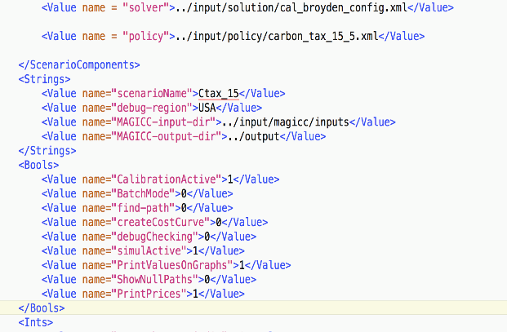
Configuration
Alternative scenarios may be run as follows:
Note: if running a CO2/GHG policy start from configuration_policy.xml
add additional XML files at the end of the existing ScenarioComponents
Change the scenarioName
Indicate whether to use target-finder (if running an end-of-century climate target)
Indicate whether to calculate abatement cost curves

Slide 53
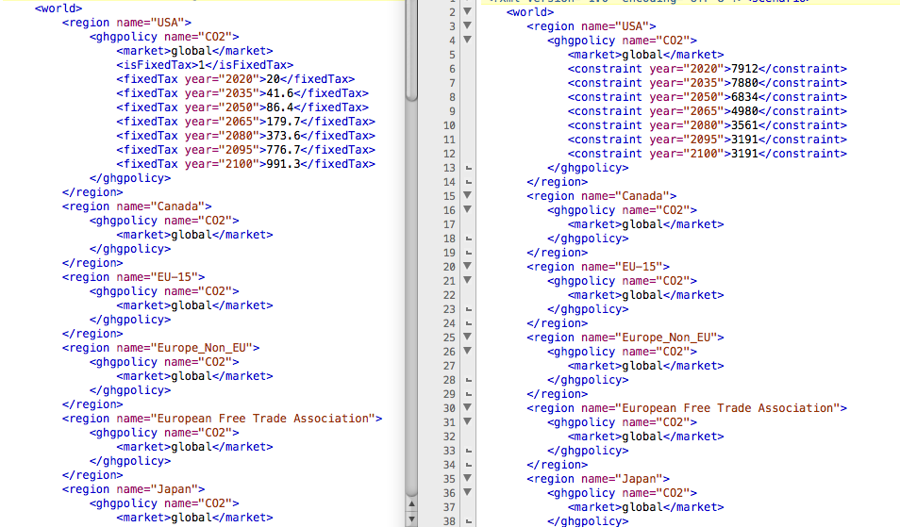
A global policy is specified in one region, and all others share in the market.
Regional policies can be specified in individual regions
Carbon price: model solves for emissions, given a fixed price
Carbon constraint: model solves for carbon price, given emissions pathway.
Economic equilibrium is not influenced by which factor was specified

Slide 54
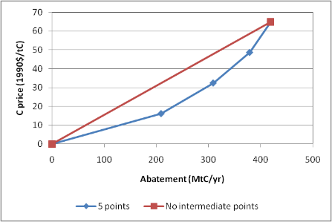
Cost curves
Emissions abatement costs are calculated as the integral under the marginal abatement cost schedule.
By default, this is calculated as the area underneath the marginal abatement curve with five points.
In the example to the right, the resulting policy costs are as follows:
5 points: $12148
No intermediate points: $13578
This scenario exhibits progressively higher marginal abatement costs with respect to abatement level
Technology influences the shape of the MAC function

Slide 55
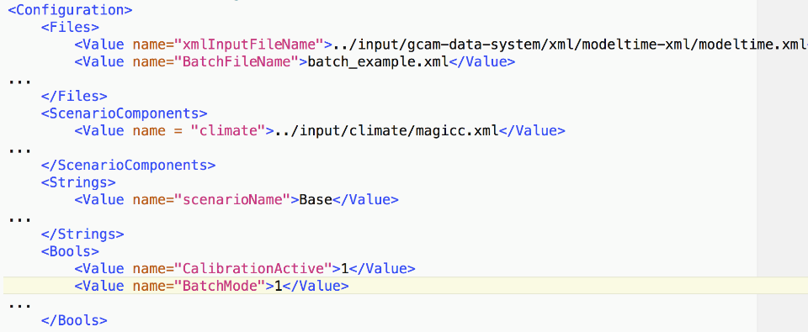
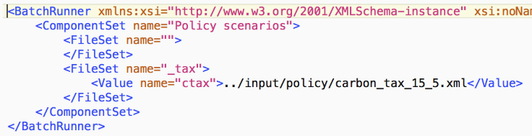
Running in batch mode
Set the bool and batch file name
Files in FileSet will be added to the scenarioComponents in the config file
scenarioName and FileSet name append (e.g., Base_tax)

Slide 56
Part 3: Changing Input Files
The gcamdata system
Modifying xml input files

Slide 57
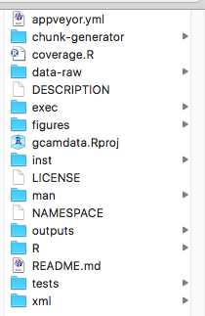
The gcamdata system
Folder structure
xml: GCAM input files (in xml format)
outputs: csv files generated by the data system
R: code files used to generate GCAM input files
zchunk_L1*, zchunk_LA1*, zchunk_LB1*: convert raw data to GCAM regions, sectors, technologies
zchunk_L2*: generate all data needed for GCAM
zchunk_batch*: generate xml input files
inst: external data used as inputs into the R code
data-raw: generates package related data

Slide 58
Modifying the xml input files
The best approach for modifying GCAM depends on what you are changing, what your intention is, and whether you want your modification to be put into the GCAM master version
Possible things to change:
Parameter that is either specified in `input/gcamdata/inst/extdata` or the `constants.R` file in the gcamdata package.
Parameter or file that is derived in the gcamdata package
Structure of a region or sector
Possible intentions:
Quick understanding
Project or paper

Slide 59
Changing a parameter that is either specified in `input/gcamdata/inst/extdata` or the `constants.R` file in the gcamdata package
If your goal is to simply understand the implications of that parameter, then just change it, rebuild the data, and run with the updated parameter.
Note 1: Make sure you first run the standard version so you have something to compare to
Note 2: Make sure you revert the change when you are done so it doesn’t make its way into other simulations
Version control and/or `driver_drake` can help keeping track and easily getting back original assumptions / XML files.
If your goal is to update the GCAM master version, then follow the steps above.

Slide 60
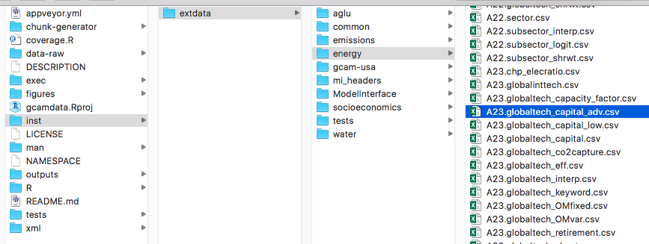
Changing a parameter that is either specified in `input/gcamdata/inst/extdata` or the `constants.R` file in the gcamdata package
Your question: what are the implications of more rapidly decreasing solar PV costs?
Default cost of PV w/ storage in 2100: $985/kW
Advanced cost PV w/ storage in 2100: $787/kW
Your desired cost: $650/kW
Option #1: Change the parameters in A23.globaltech_capital_adv.csv to get your desired cost and re-run the gcamdata system. The `solar_adv.xml` file will include your updated costs.

Slide 61
Changing a parameter that is either specified in `input/gcamdata/inst/extdata` or the `constants.R` file in the gcamdata package
If your goal is to simply understand the implications of that parameter, then just change it, rebuild the data, and run with the updated parameter.
Note 1: Make sure you first run the standard version so you have something to compare to
Note 2: Make sure you revert the change when you are done so it doesn’t make its way into other simulations
If your goal is to update the GCAM master version, then follow the steps above.
If your goal is to write a paper comparing the model under different parameters:
The option above will theoretically work, but it is difficult to reproduce and document.
Instead, we recommend that you modify the data system to create a new xml file. Additionally, creating a batch file to iterate through the different options is recommended.

Slide 62
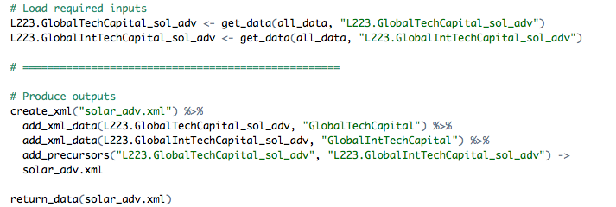
Changing a parameter that is either specified in `input/gcamdata/inst/extdata` or the `constants.R` file in the gcamdata package
Option #2: Create a new chunk by copying `zchunk_batch_solar_adv_xml`, then modify the data in that chunk to create a new xml file with your desired cost. You will need to rebuild and re-run the data system to generate the new file.
Your question: what are the implications of more rapidly decreasing solar PV costs?
Default cost of PV w/ storage in 2100: $985/kW
Advanced cost PV w/ storage in 2100: $787/kW
Your desired cost: $650/kW
Add code here to change the cost (either overwriting data in one of the files above or reading in a new file).
Update file name here.

Slide 63
Changing a parameter or file that is derived in the gcamdata package
Regardless of your intention, you will need to modify the R code in the gcamdata system.
If you are just trying to understand the implications or are intending to modify the GCAM core, then you can just modify the calculation in the relevant part of the code.
If your goal is to write a paper studying this parameter or the information in this file, then you will want to ensure the data system includes/generates both the original calculation/file and the new one.

Slide 64
Modifying the structure of a region or sector
It is difficult to give general advice in this case, because exactly how you make this change depends on what you are trying to do.
Some general advice:
Start small. Make the smallest change possible at each step so you can identify when things go wrong.
If possible use the “add-on” approach so your changes are in it’s own XML and delete/replace some part of the model (GCAM-USA approach)
You can create your test xml file in whatever manner is easiest (e.g., typing by hand or copying and editing an existing one). However, if you are planning to use the end result in a paper or in the GCAM master, then you will need to create it via the data system at some point. This is likely to be easier sooner rather than later.
Be very careful when changing calibration values.
Use GitHub issues to ask for more help: https://github.com/jgcri/gcam-core/issues

Slide 65
Additional notes for developments you wish to get into the GCAM master
If you are intending for your change to become part of the GCAM master, you will need to ensure that the GCAM coding style is used and that the code is well documented.
HINT: starting from an existing code file will help ensure the guidelines are met.
More information is available at: http://jgcri.github.io/gcam-doc/dev-guide.html

Slide 66
Part 4: Debugging
This section will focus on the most common problems
It will not attempt to cover everything that could happen, because there would be way too much to cover

Slide 67
Types of messages
GCAM prints different levels of messages to help identify issues.
WARNING: a notification of a potential problem; however, since this could be benign the model will continue (e.g., unrecognized text string in an xml input file)
ERROR: a notification of a likely problem. in some cases, the model will continue to run (e.g., the sum of area read in for all land leafs in a region is more than 0.1% different from the total area read in for that region); in other cases, the model will abort (e.g., if the difference is more than 5%)
SEVERE: Major issue that will prohibit the model from running properly (e.g., no world within the scenario container)

Slide 68
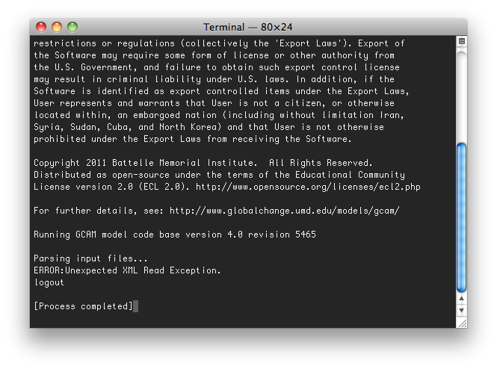
Configuration/input errors
Possible causes
The gcamdata system has not yet been run or did not produce XMLs
The XMLInputFileName or BatchFileName (or their pathways) are incorrect
If running from code editor, the project’s working directory needs to be set to the exe/ folder. Sometimes it defaults to the cvs/objects/build/*/ folder
Problem: Immediate crash

Slide 69
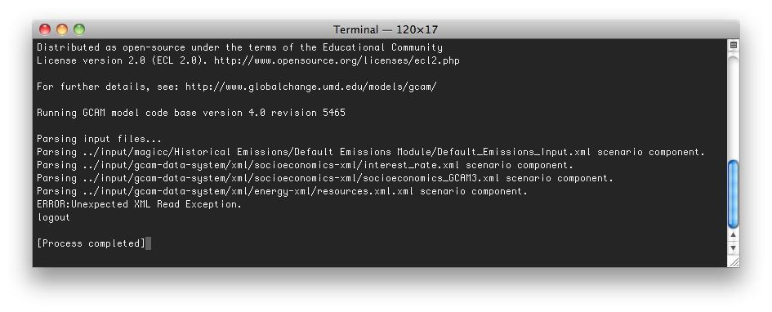
Configuration/input errors
Problem: crash while reading in the ScenarioComponents XML files
Possible causes:
File was not found (look for typos in the file name)
File was not correctly formatted (when edited by hand)
Notes:
Could use an XML viewer to help diagnose formatting errors such as a web browser

Slide 70
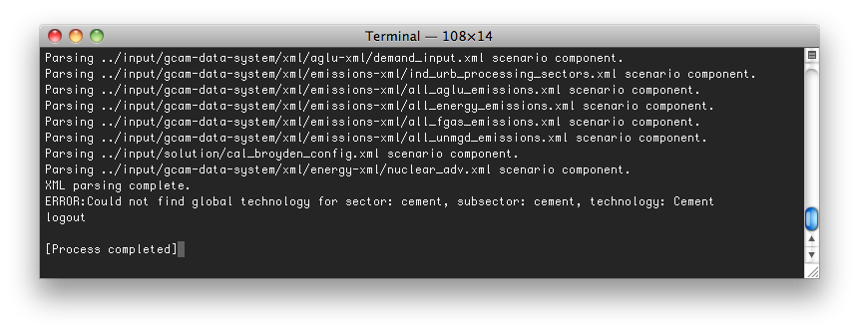
Configuration/input errors
Problem: crash after XML parsing, before first period
Possible causes:
Mis-spelled a technology name (Cement instead of cement). Strings in GCAM are case-sensitive.
Missing technology
Added some land input in some region / basin / crop combination that does not exist

Slide 71
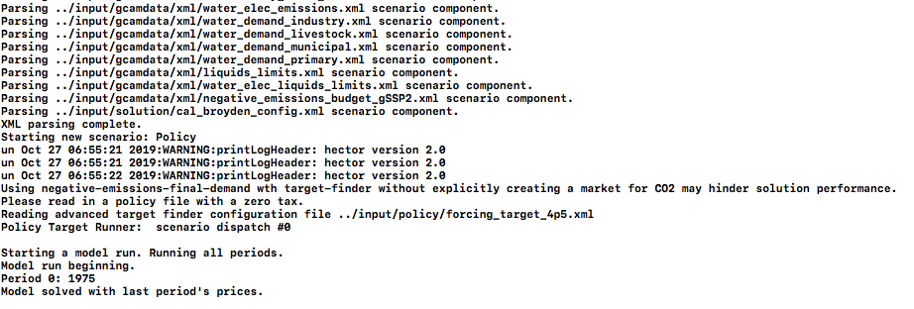
Configuration/input errors
Problem: message printed to screen about explicitly creating a market for CO₂ (model will not abort, but will have solving problems later)
Cause: A carbon price must be read in with target finder in order to set up dependencies. Be sure to start from configuration_policy.xml

Slide 72
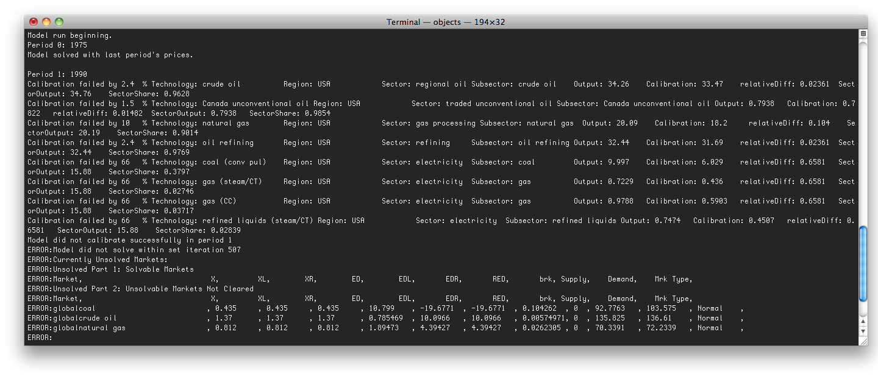
Calibration Failures versus Solver Failures
Calibration failure: Read-in values for supply and demand don’t match
Solver failure: model cannot find a set of prices where supply and demand are equal for all commodities
Notes:
Note that you can have a calibration failure without a solver failure and vice versa.

Slide 73
Errors from changes to input files
Problem: the model does not calibrate or solve the base years:
Cause: Unbalanced supply and demand in calibration years. Check all calibration data, including coefficients to debug. In this case, the base-year electricity input-output coefficient of cement production was changed, causing system-wide imbalances between electricity demand and supply.

Slide 74
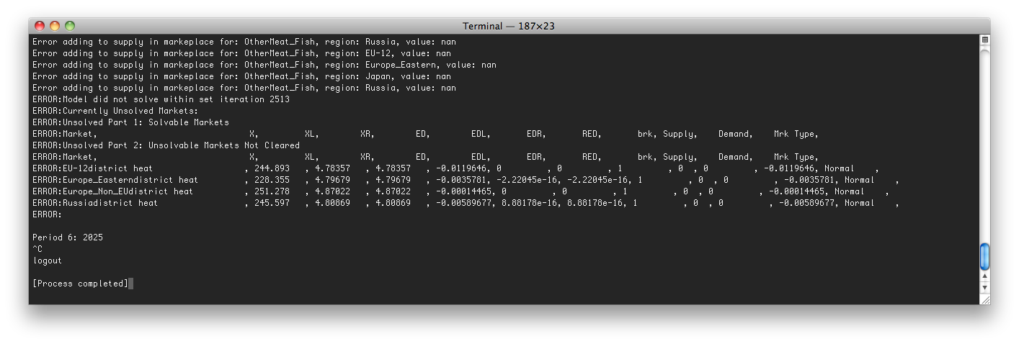
Model not solving
Problem: the model fails to solve in some period
Cause: solution issues can be difficult to decipher
Useful to make ”one” change at a time
Double check your configuration
Use supply / demand curves feature to check problem markets (input/extra/supply_demand_curves.xml)

Slide 75
Model not solving
Solver failures can be difficult to diagnose. Some things to try:
Look for discontinuities or vertical supply or demand curves, either by thinking about what you’ve changed that could have led to that OR by using the supply-demand curve calculator to print the curves.
Use https://github.com/JGCRI/gcamwrapper to debug interactively from R or Python
Well-behaved and intersecting. Should solve easily.

Slide 76
Model not solving
Solver failures can be difficult to diagnose. Some things to try:
Look for discontinuities or vertical supply or demand curves, either by thinking about what you’ve changed that could have led to that OR by using the supply-demand curve calculator to print the curves.
Non-intersecting.
Will not solve.

Slide 77
Model not solving
Solver failures can be difficult to diagnose. Some things to try:
Look for discontinuities or vertical supply or demand curves, either by thinking about what you’ve changed that could have led to that OR by using the supply-demand curve calculator to print the curves.
Intersecting, but includes a discontinuity.
Can solve, but may be difficult.

Slide 78
Model not solving
Solver failures can be difficult to diagnose. Some things to try:
Look for discontinuities or vertical supply or demand curves, either by thinking about what you’ve changed that could have led to that OR by using the supply-demand curve calculator to print the curves.
Increase the iteration count in the solver configuration file. [Note: there is no guarantee this will work, but it is easy to try and has helped in the past]
Ask for help on GitHub: https://github.com/jgcri/gcam-core/issues

Slide 79
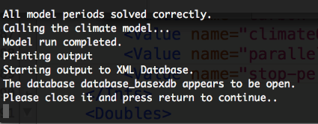
Database open while trying to write
The model can’t write to the output database
In prior versions, the database could be open while GCAM was writing to it; this is no longer the case with the switch to the basexdb

Slide 80
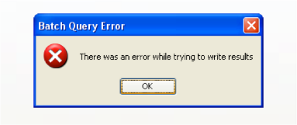
Queries – general
Message: “The query returned no results”
Misspelling the name of a variable or sector
The market may not exist (e.g. C price in a non-policy run)
The syntax of the XPATH may be wrong (e.g. not enough slashes)
Batch query error:
The Excel workbook being written to was open during the export

Slide 81
Part 5: Additional Resources
Online resources:
GCAM documentation: http://jgcri.github.io/gcam-doc/toc.html
Developer’s guide: http://jgcri.github.io/gcam-doc/dev_guide.html
Asking for help:
gcam-core GitHub issues: https://github.com/jgcri/gcam-core/issues
gcam-doc GitHub issues: https://github.com/JGCRI/gcam-doc/issues

Slide 82
Part 6: Theory and meaning of parameters
This section focuses on the meaning of several key input parameters found throughout the input XML file set
Elasticities
Logit exponents
Share-weights and interpolation rules
Efficiencies and coefficients

Slide 83


Elasticity
Price elasticity: The percent change in demand of a good divided by the percent change in the price
Income elasticity: The percent change in demand of a good divided by the percent change in GDP

Slide 84

Service price elasticity ≠ fuel price elasticity
Service price elasticities include ALL costs of providing the energy service
Levelized capital costs, fixed O&M, variable O&M
In passenger transportation, service costs may include time value costs

Slide 85
Efficiencies and coefficients
Efficiency = output / input
Coefficient = input / output
Coefficients make more sense where there are multiple inputs
Where the input-unit and output-unit are the same, these parameters are unitless. For several sectors in GCAM, however, the input-unit and output-unit differ, e.g.:
Transportation coef: BTUs fuel per vehicle kilometer
Cement coef: GJ of energy per kg of cement
Fertilizer coef: GJ of energy per kg of N fertilizer
Nuclear fuel efficiency: GJ of energy per kg of uranium

Slide 86

Logit-exponents and fuel-switching
The logit exponents control the degree of switching between technologies or fuels in response to price changes
Low values = low fuel-switching = strong influence of base year shares even far into the future
High values tend towards winner-take-all responses in response to changes in costs

Slide 87


Share-weights
The roles of the share-weight
Calibration parameter
Phasing in new technologies
Allows gradual movement away from the base year’s calibrated share weight values
Without any phase-in, markets rapidly transition in response to introductions of new technologies

Slide 88

Interpolation
Interpolation is primarily used for defining share-weight pathways into the future
Fixed: carry the shareweight in the “from-year” to the “to-year” with no changes. Requires a from-value.
Linear: linearly interpolate. Requires a from-value and a to-value, which can be set within the interpolation rule, or in the share-weight parameter.
S-curve: s-curve shaped function. Requires a from-value and a to-value. Note that the to-year doesn’t need to be a model time period, but if it isn’t, need to set the “to-value” within the rule.

